Slide 1



Performance Management for Senior Leadership
Building Accountability, Alignment & High Performance
Glooscap First Nation / Glooscap Ventures
Flourish Abumere, Director of HR & Policy
2025–2026

Slide 2
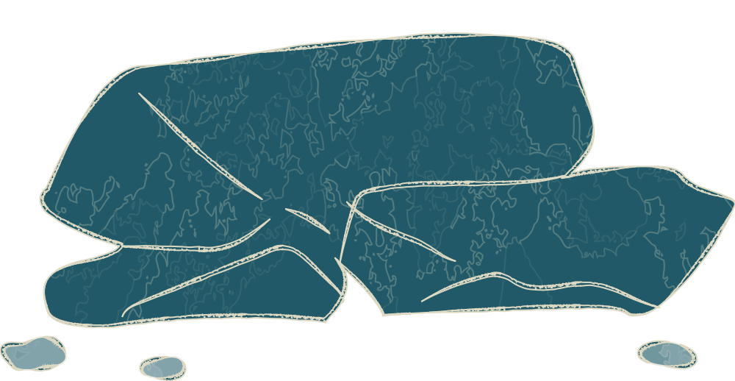


Why This Matters at the Senior Leadership Level
Performance management is not an HR activity — it is a leadership responsibility.
Effective performance management: Protects the organization legally and reputationally. Enables fair compensation and promotion decisions. Reduces grievances, conflict, and inconsistent discipline. Strengthens succession planning and talent retention. Improves service delivery to community and stakeholders.

Slide 3
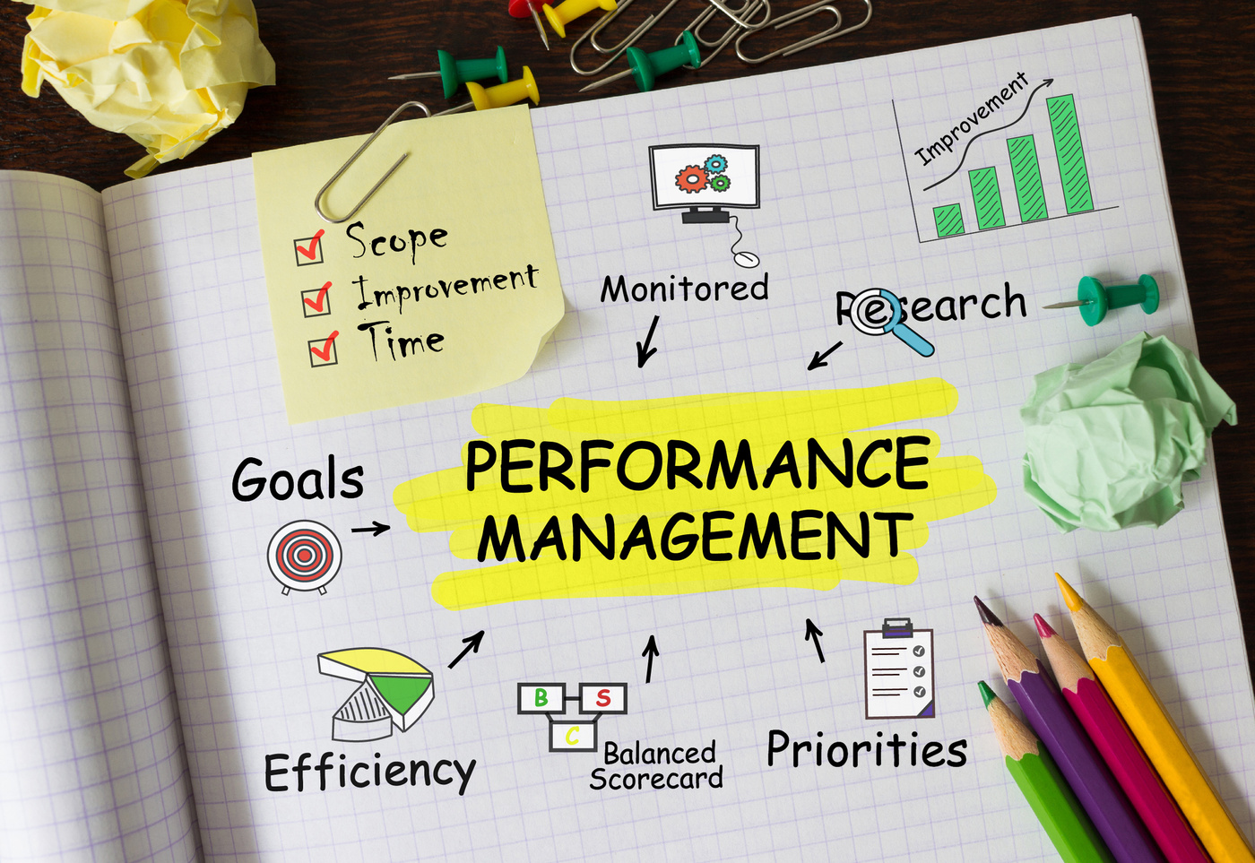
What Performance Management Is (and Is Not)
Performance Management IS:
Ongoing, structured, and documented.
Aligned with organizational priorities.
Focused on accountability and development.
Consistent and fair across departments.
Performance Management IS NOT:
A once-a-year form
A disciplinary ambush
Subjective opinion
An HR-only process

Slide 4
Leadership Accountability Model
Performance management succeeds only when roles are clear.
Role | Core Accountability
Senior Leadership | Tone, consistency, resourcing, accountability
Managers | Goal-setting, feedback, documentation
HR | Framework, training, compliance, escalation

Slide 5
The Performance Management Cycle
A continuous leadership process, not an event.
Clear goal setting
Ongoing feedback & coaching
Mid-year check-in
Year-end evaluation
Development & reward decisions

Slide 6

Strategic Goal Alignment (Leadership Focus)
🎯 Goals align with organizational priorities.
📄 Job descriptions accurately reflect actual work.
📏 Expectations are realistic, measurable, and clear.
🔄 Objectives are applied consistently across teams.
⚠️ Poorly aligned goals create risk, disengagement, and inequity.

Slide 7


What Good Goals Look Like
Effective goals are:
Example leadership-level goals:
Improve response time to internal requests to under 48 hours
Specific
Achieve 95% attendance at required team meetings
Measurable
Relevant
Reduce backlog or service delays by 50%
Achievable
Time-Bound

Slide 8






Feedback Is a Leadership Obligation
Senior leaders must ensure:
1
2
Feedback happens early and often
Issues are addressed promptly
3
4
Employees are not surprised at review time
Managers are supported to have difficult conversations

Slide 9









Underperformance: The Leadership Lens
01
02
03
Addressed promptly and not avoided.
Based on objective facts and evidence, not assumptions.
Clearly documented with specific examples.
04
05
06
Supported with coaching, resources, or training where appropriate.
Managed consistently across departments and roles.
Handled in a fair, respectful, and legally defensible manner.

Slide 10




Performance Improvement Plans (PIPs)
A PIP is:
A structured support tool.
Time-bound and measurable.
Backed by training, coaching, or resources.
A shared responsibility between manager, employee, and HR.

Slide 11
Performance Management as Risk Mitigation
Leadership Risk If Performance Management Is Weak:
01
02
03
04
05
Human rights complaints
Claims of bias or favoritism
Weak termination decisions
Grievances and disputes
Inconsistent discipline
Ask yourself:
Would this decision stand up if reviewed externally?

Slide 12
Bias & Fairness: Senior Leader Responsibility
Halo or horns effect (allowing one trait or incident to influence the full assessment)
Cultural or communication bias (misinterpreting style, tone, or background).
01
04
Senior leaders must actively guard against:
Leniency or severity bias (rating too generously or too harshly)
Inconsistent application of standards across teams or departments.
02
05
Proximity bias (favouring those seen more often or working on-site).
Unconscious bias influencing decisions on ratings, discipline, or development.
03
06

Slide 13
If reviews don’t drive development,
Training investments
Succession planning
Leadership development
Internal mobility
the process has failed.
Development & Succession
Performance management should inform:

Slide 14
What HR Will Support
HR will:
🛠️ Provide tools, templates, and training.
💬 Support difficult and sensitive performance conversations.
⚖️ Ensure legal, policy, and regulatory compliance.
🚨 Escalate risks appropriately and in a timely manner.
🔄 Maintain consistency across departments and leadership teams.
HR is a partner — not the owner of performance.

Slide 15
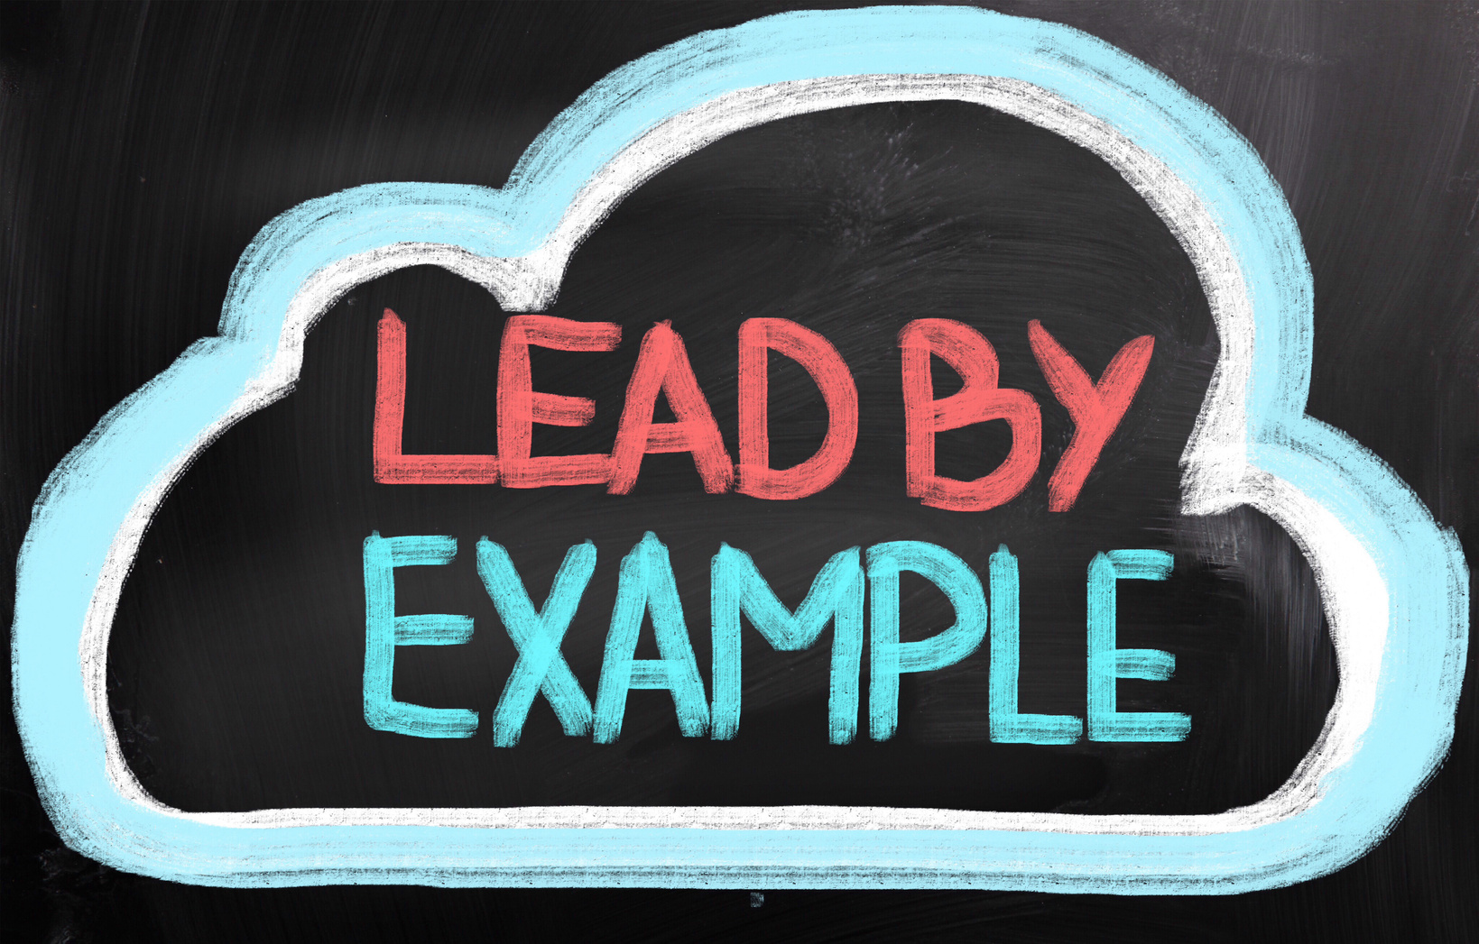
What We Expect From Senior Leaders
Senior leaders are expected to:
  Champion performance accountability.
  Hold managers accountable for follow-through.
  Address patterns, not just individuals.
  Support fair and timely decisions.
  Model feedback-friendly leadership.

Slide 16

What Success Looks Like
In 12 months, success means:
  Clear expectations across teams
  Fewer performance surprises
  Stronger documentation
  Fairer decisions
  Higher engagement and trust

Slide 17
Closing
Performance management is how leadership shows fairness, courage, and accountability.
HR is here to support you - leadership is what makes it work.

Slide 18
Resources
Confederacy of Mainland Mi’kmaq (CMM)
Performance Management – How to get it right. https://cmmns.com
University of Western Ontario, Ivey Executive Education - Managing performance as an emerging leader, December 21st, 2020. https://www.ivey.uwo.ca/executive-education/insights/2020/12/managing-performance-as-an-emerging-leader/
Job Bank (Government of Canada) – Manage Employees
Employer resources on identifying training needs, assessing performance, providing feedback, and reviewing performance.
Manage employees - Job Bank

